Slide 1
Facial Recognition: Pi 5 vs Pi 4
By: Daniel Alvarez, Franco Doval , Martin Navarrete, Kevyn Santos

Slide 2
Hardware Tested
Raspberry PI 5 8gb model
Raspberry PI 4 8gb model B
SoC/CPU: Broadcom BCM2712, quad-core Arm Cortex-A76 @ 2.4 GHz
Memory: 8GB
SoC/CPU: Broadcom BCM2711, quad-core Arm Cortex-A72 @ up to 1.8 GHz
Memory: 8GB
Note: Both PIs were tested with Raspberry Pi Camera Module V2-8Megapixel,1080p

Slide 3
Libraries we used for Facial Recognition
OpenCV – This is an open-source library designed for computer vision and image processing.
It is used to get each frame from the camera, resize it (for speed), convert color space, pass it to the face-recognition library, then draw the bounding box + name label on the frame.
Face_Recognition Library – This library focuses on the math behind identifying faces
It is used to detect where faces are in the image, converts faces into unique numeric encodings, and comparing those encodings to manually stored records to determine if there is a match.

Slide 4
Testing and Gathering Data
We gathered data with 0 - 4 faces detected.
We tested the performance of both Pi's at two resolutions.
640 x 480 & 1280 x 720
Ensured a consistent testing environment.
Data Gathered:
CPU Utilization (%)
CPU Temperature (°C)
Memory Utilization (%)
FPS

Slide 5
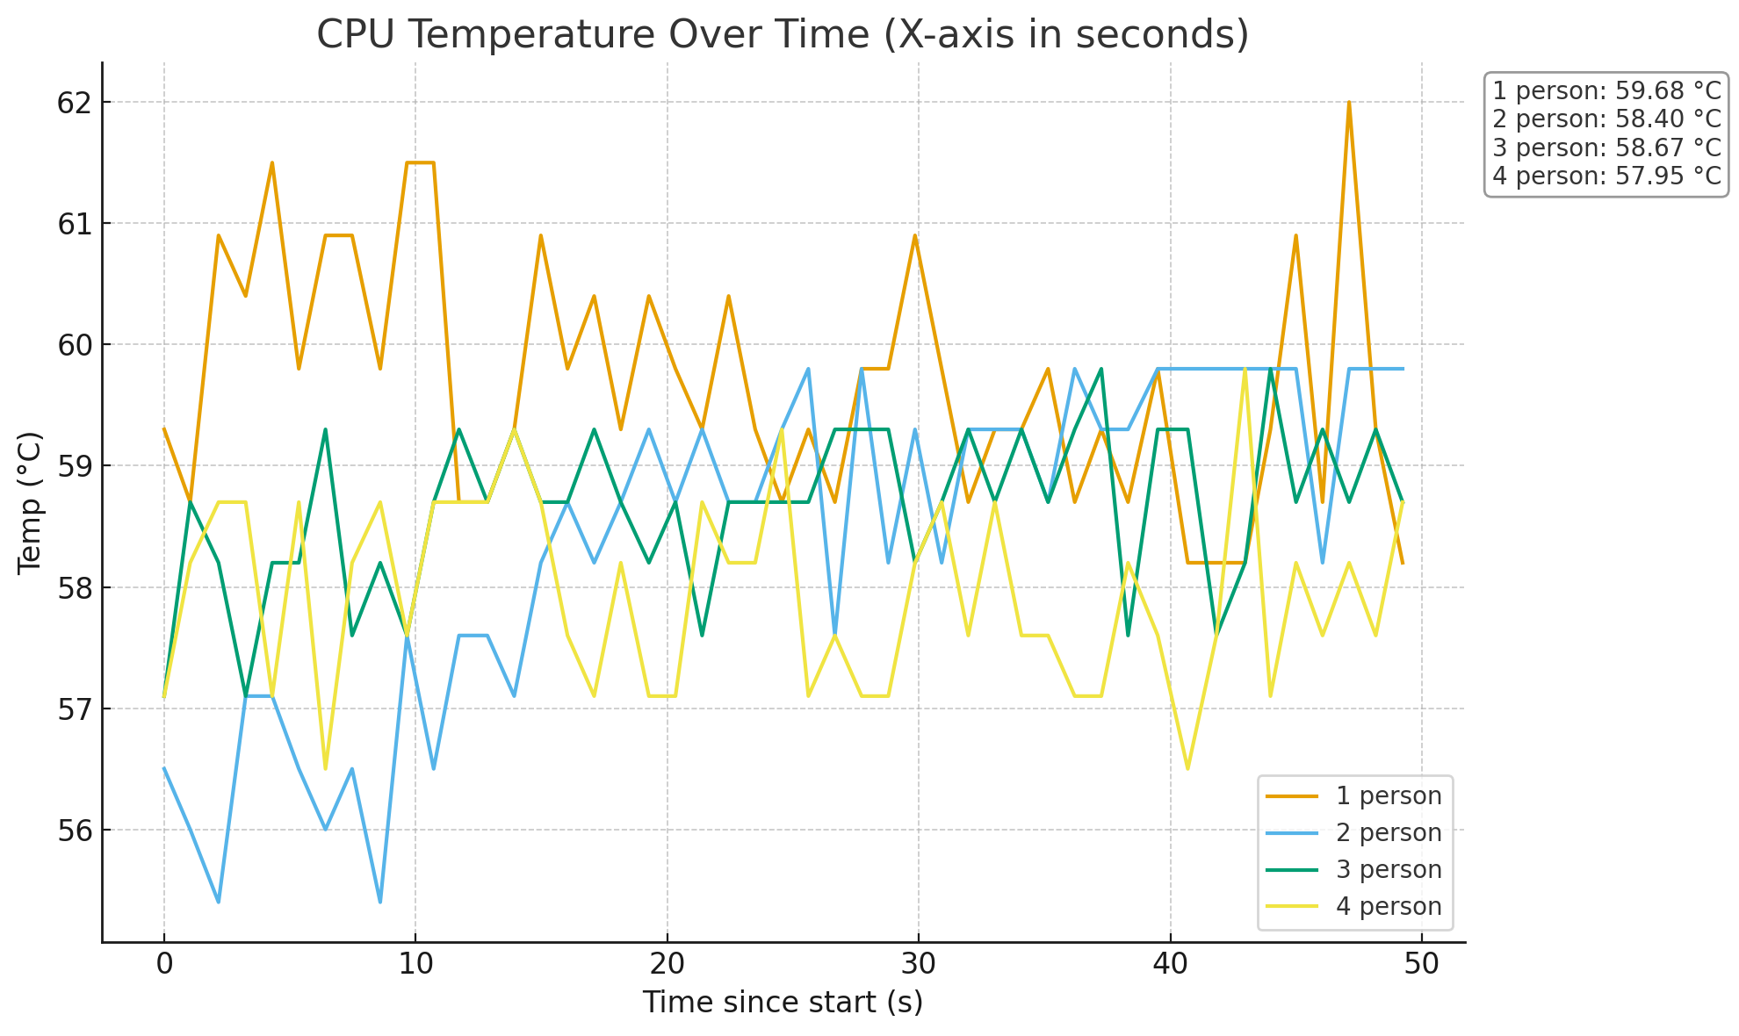
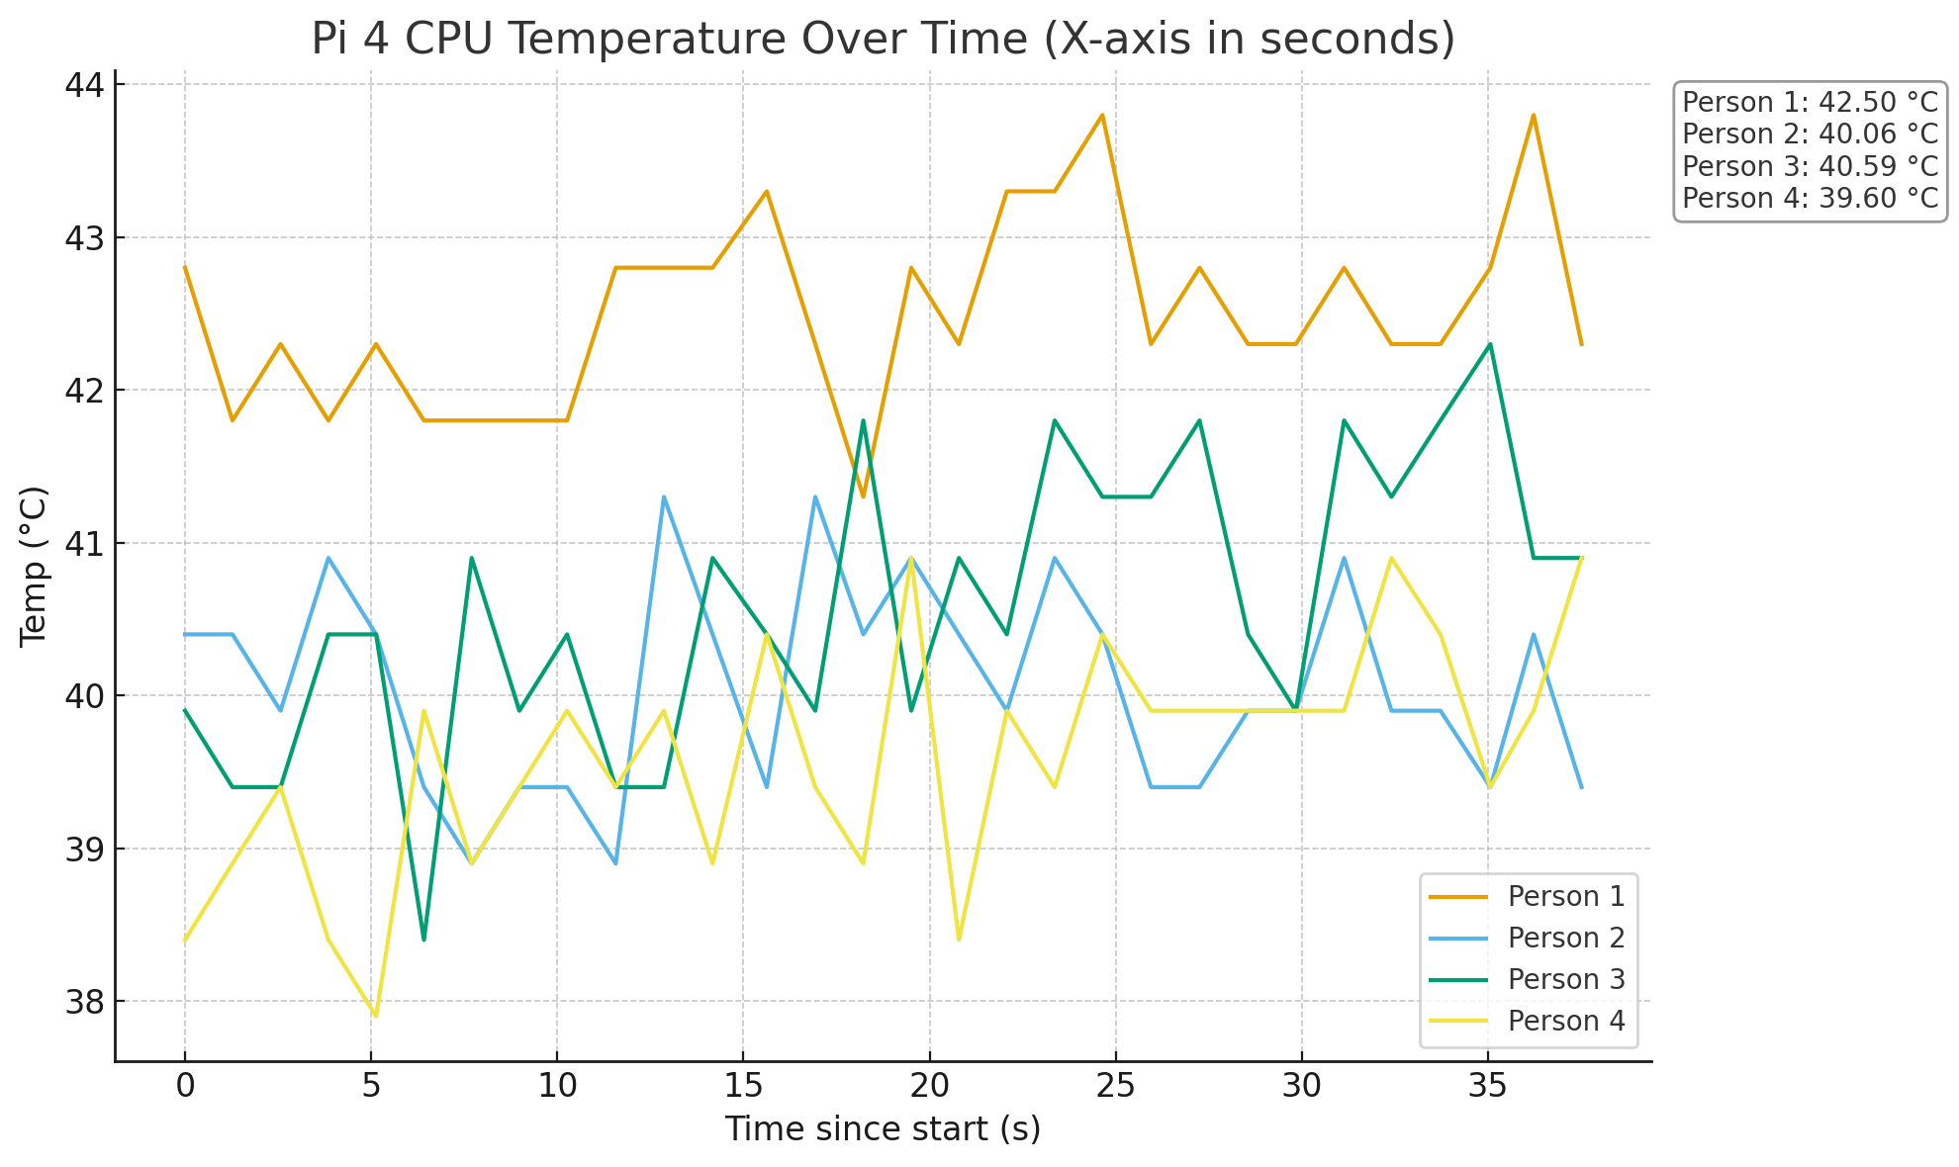
CPU Temperature comparison at 1280 x 720
Pi 5
Pi 4

Slide 6
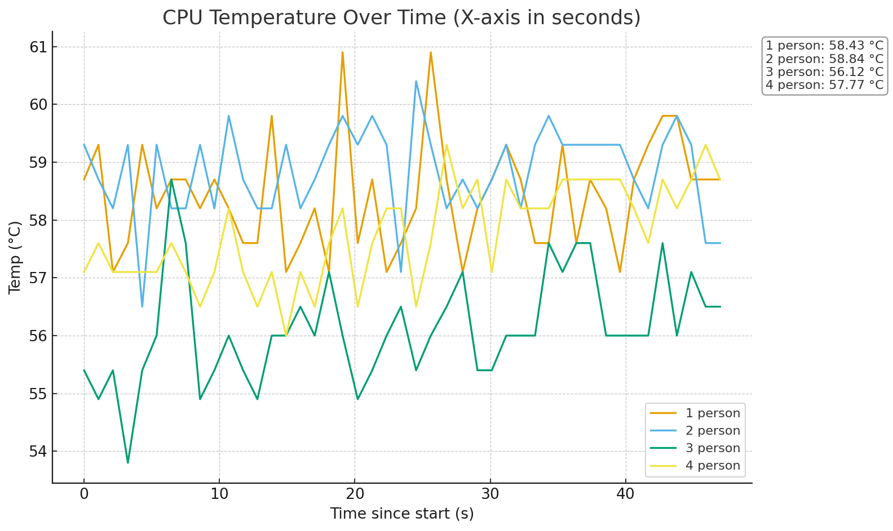
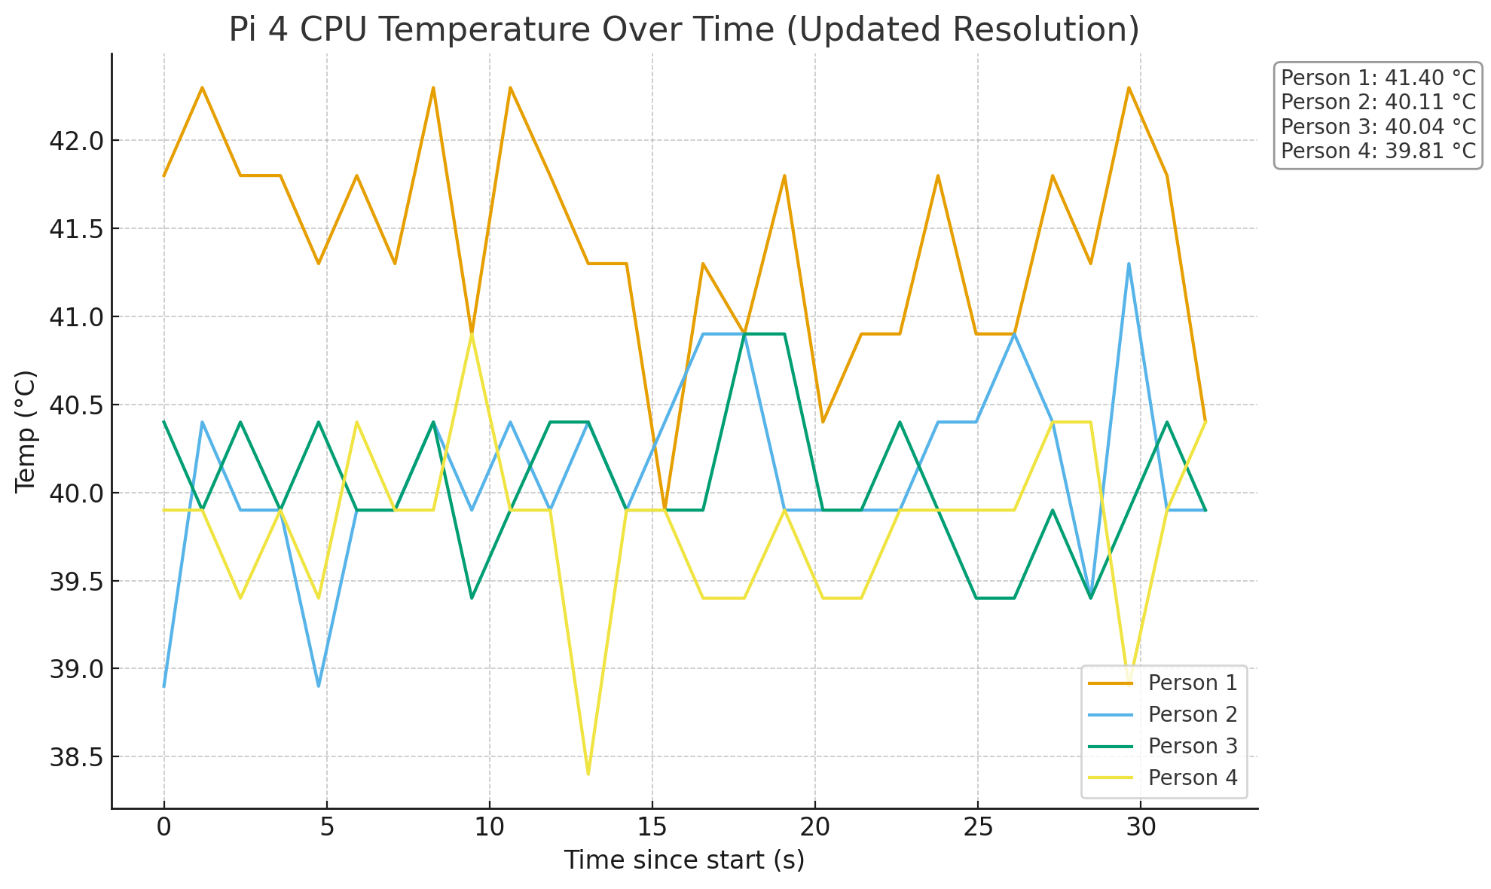
CPU Temperature comparison at 640 x 480
Pi 5
Pi 4

Slide 7
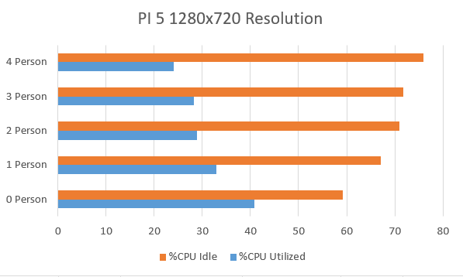
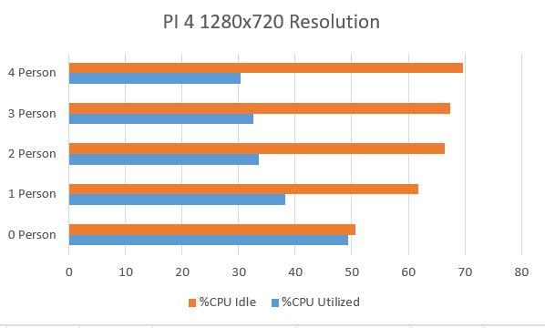
CPU Utilization comparison at 1280 x 720
Pi 5
Pi 4

Slide 8
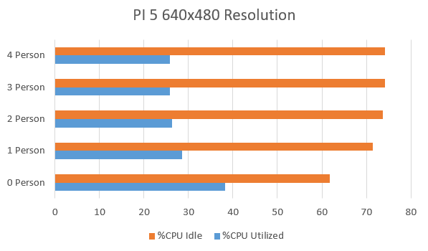
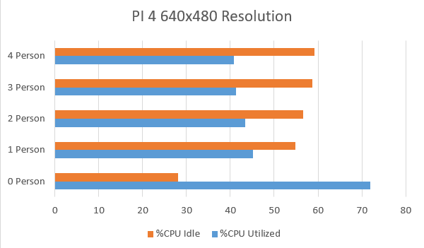
CPU Utilization comparison at 640 x 480
Pi 5
Pi 4

Slide 9
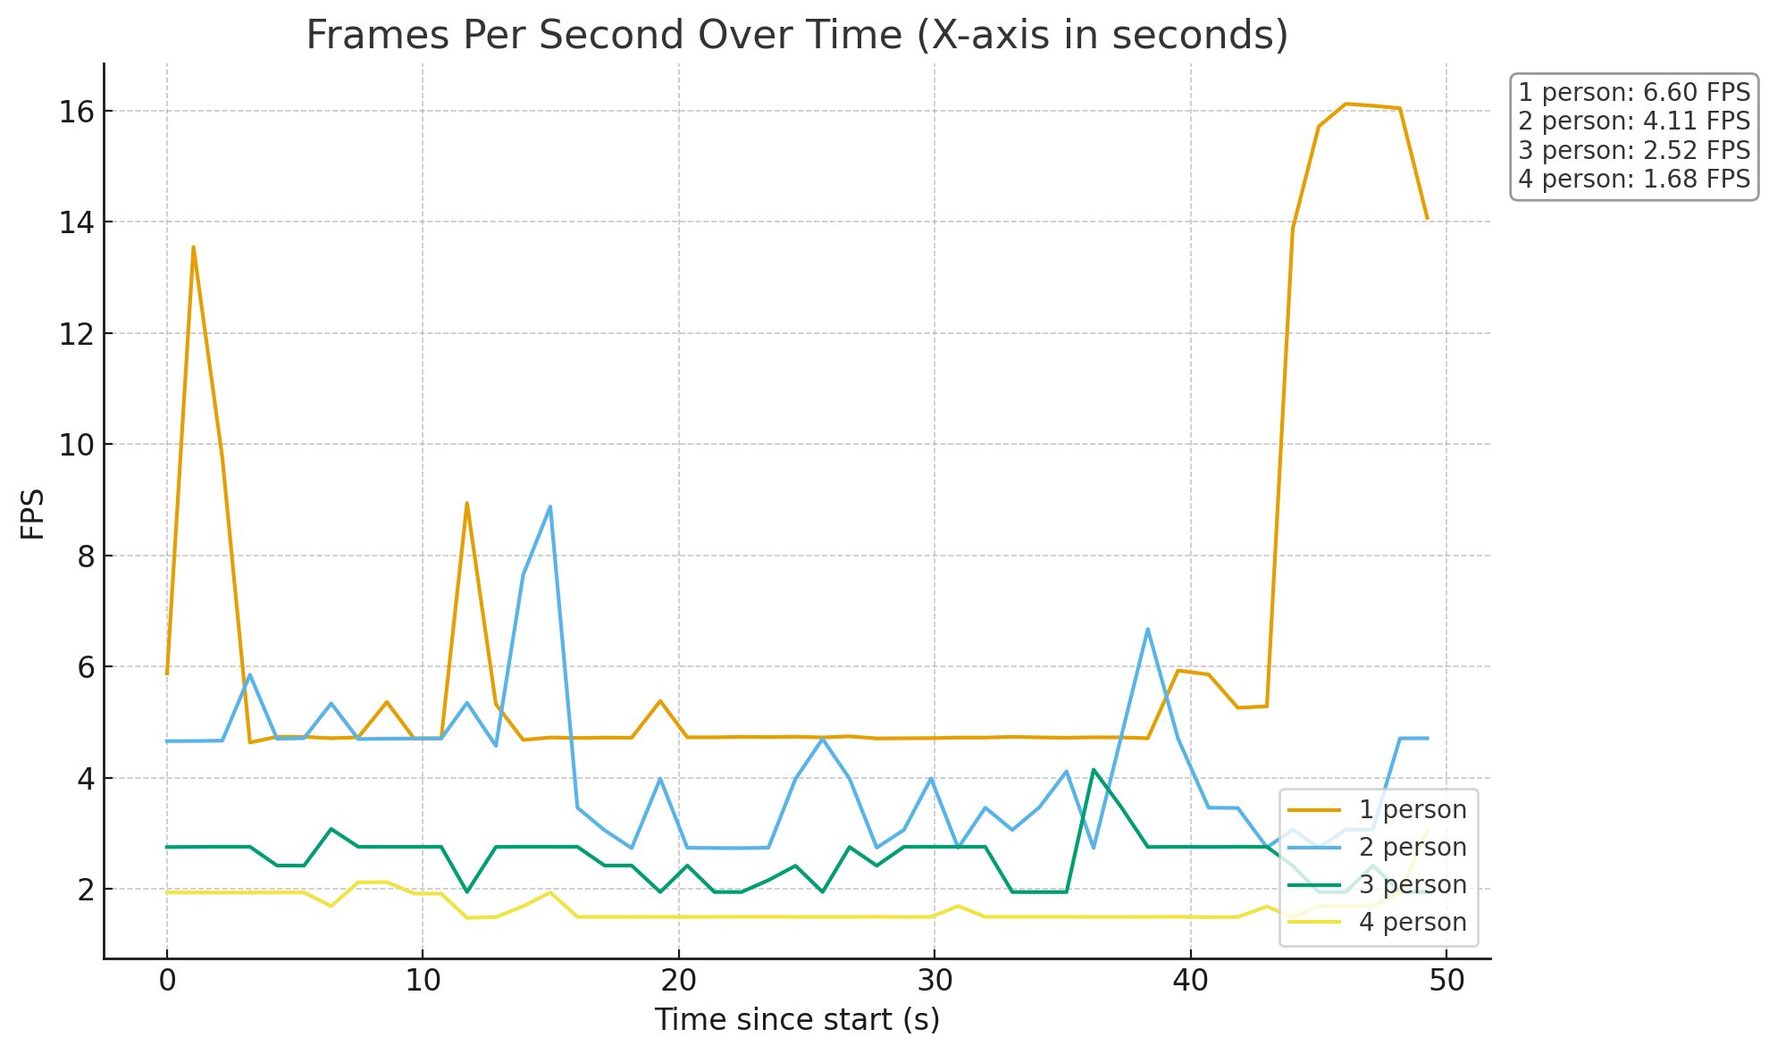
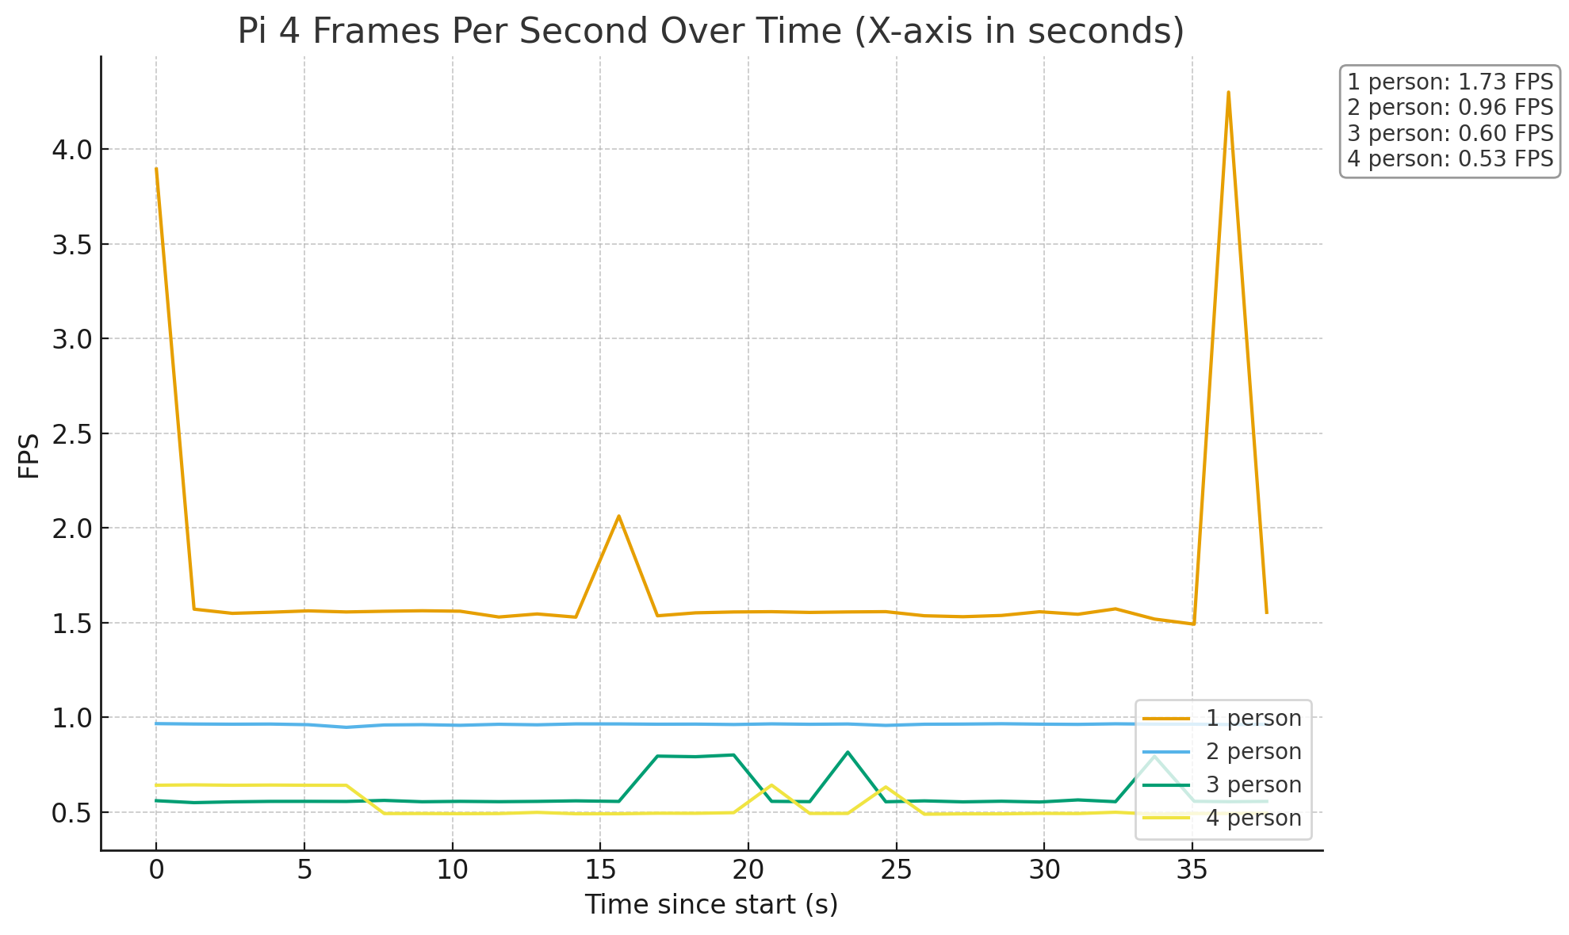
FPS comparison at 1280 x 720
Pi 5
Pi 4

Slide 10
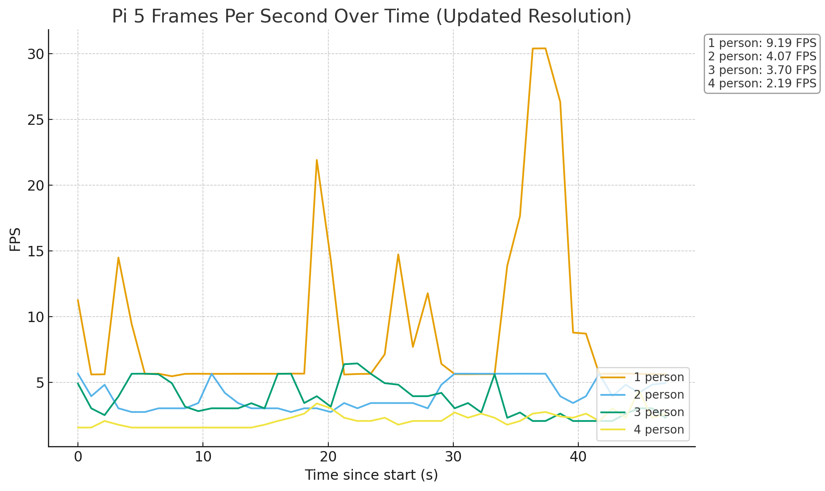
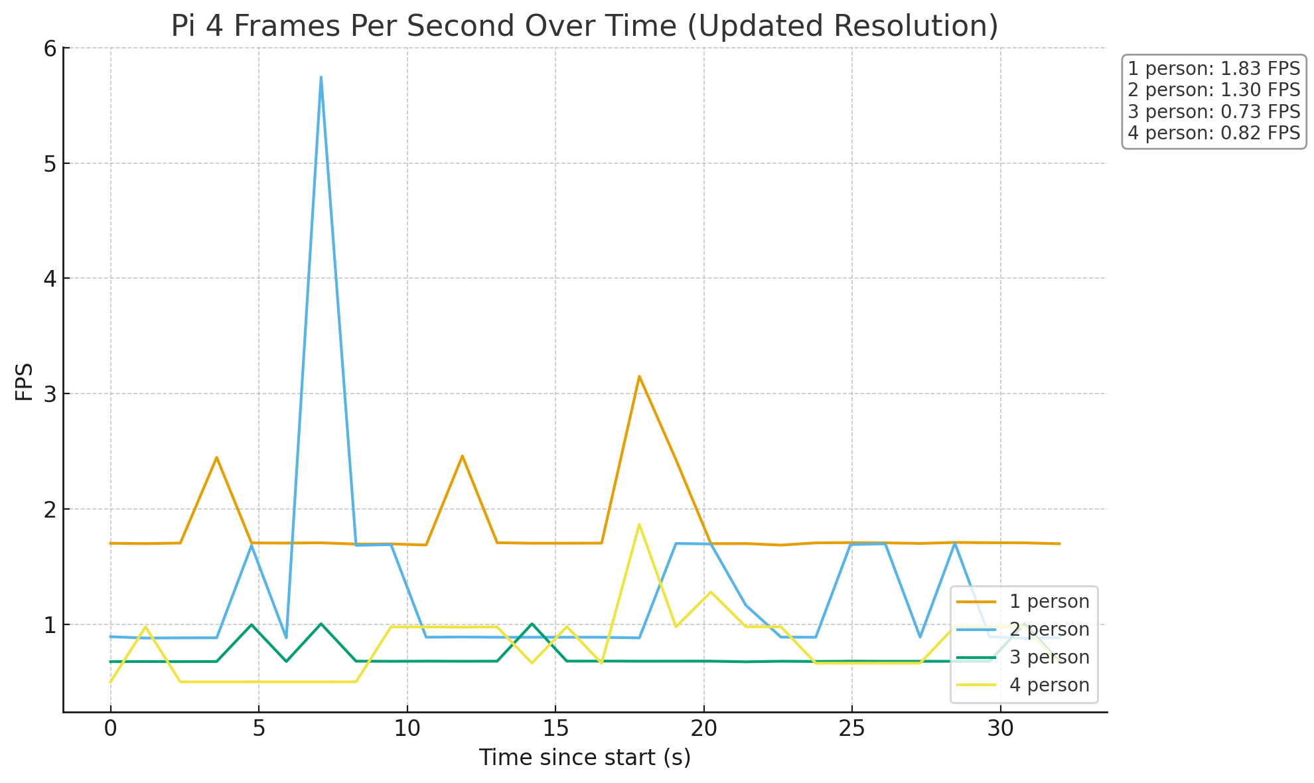
FPS comparison at 640 x 480
Pi 5
Pi 4

Slide 11
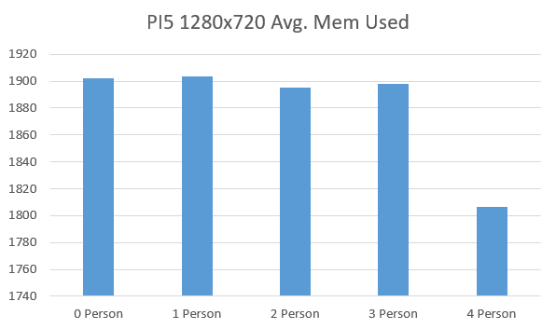
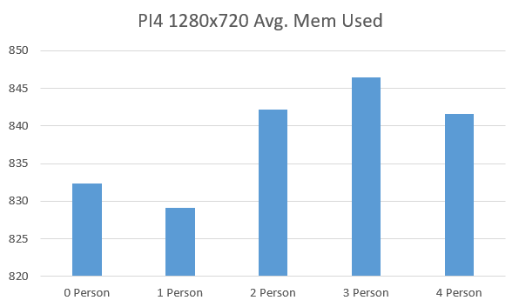
RAM Utilization comparison at 1280 x 720
Pi 5
Pi 4

Slide 12
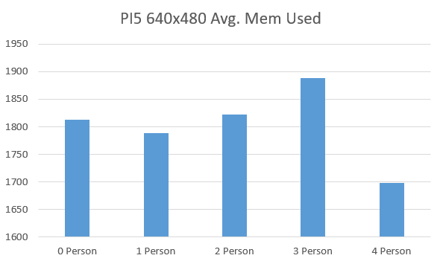
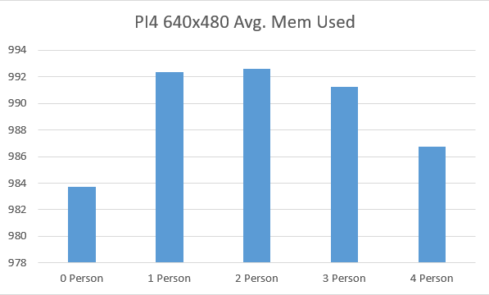
RAM Utilization comparison at 640 x 480
Pi 5
Pi 4

Slide 13
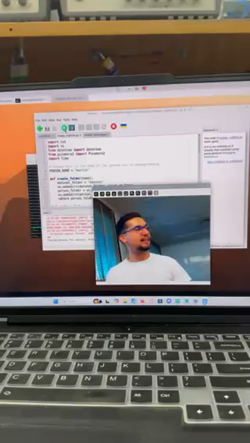
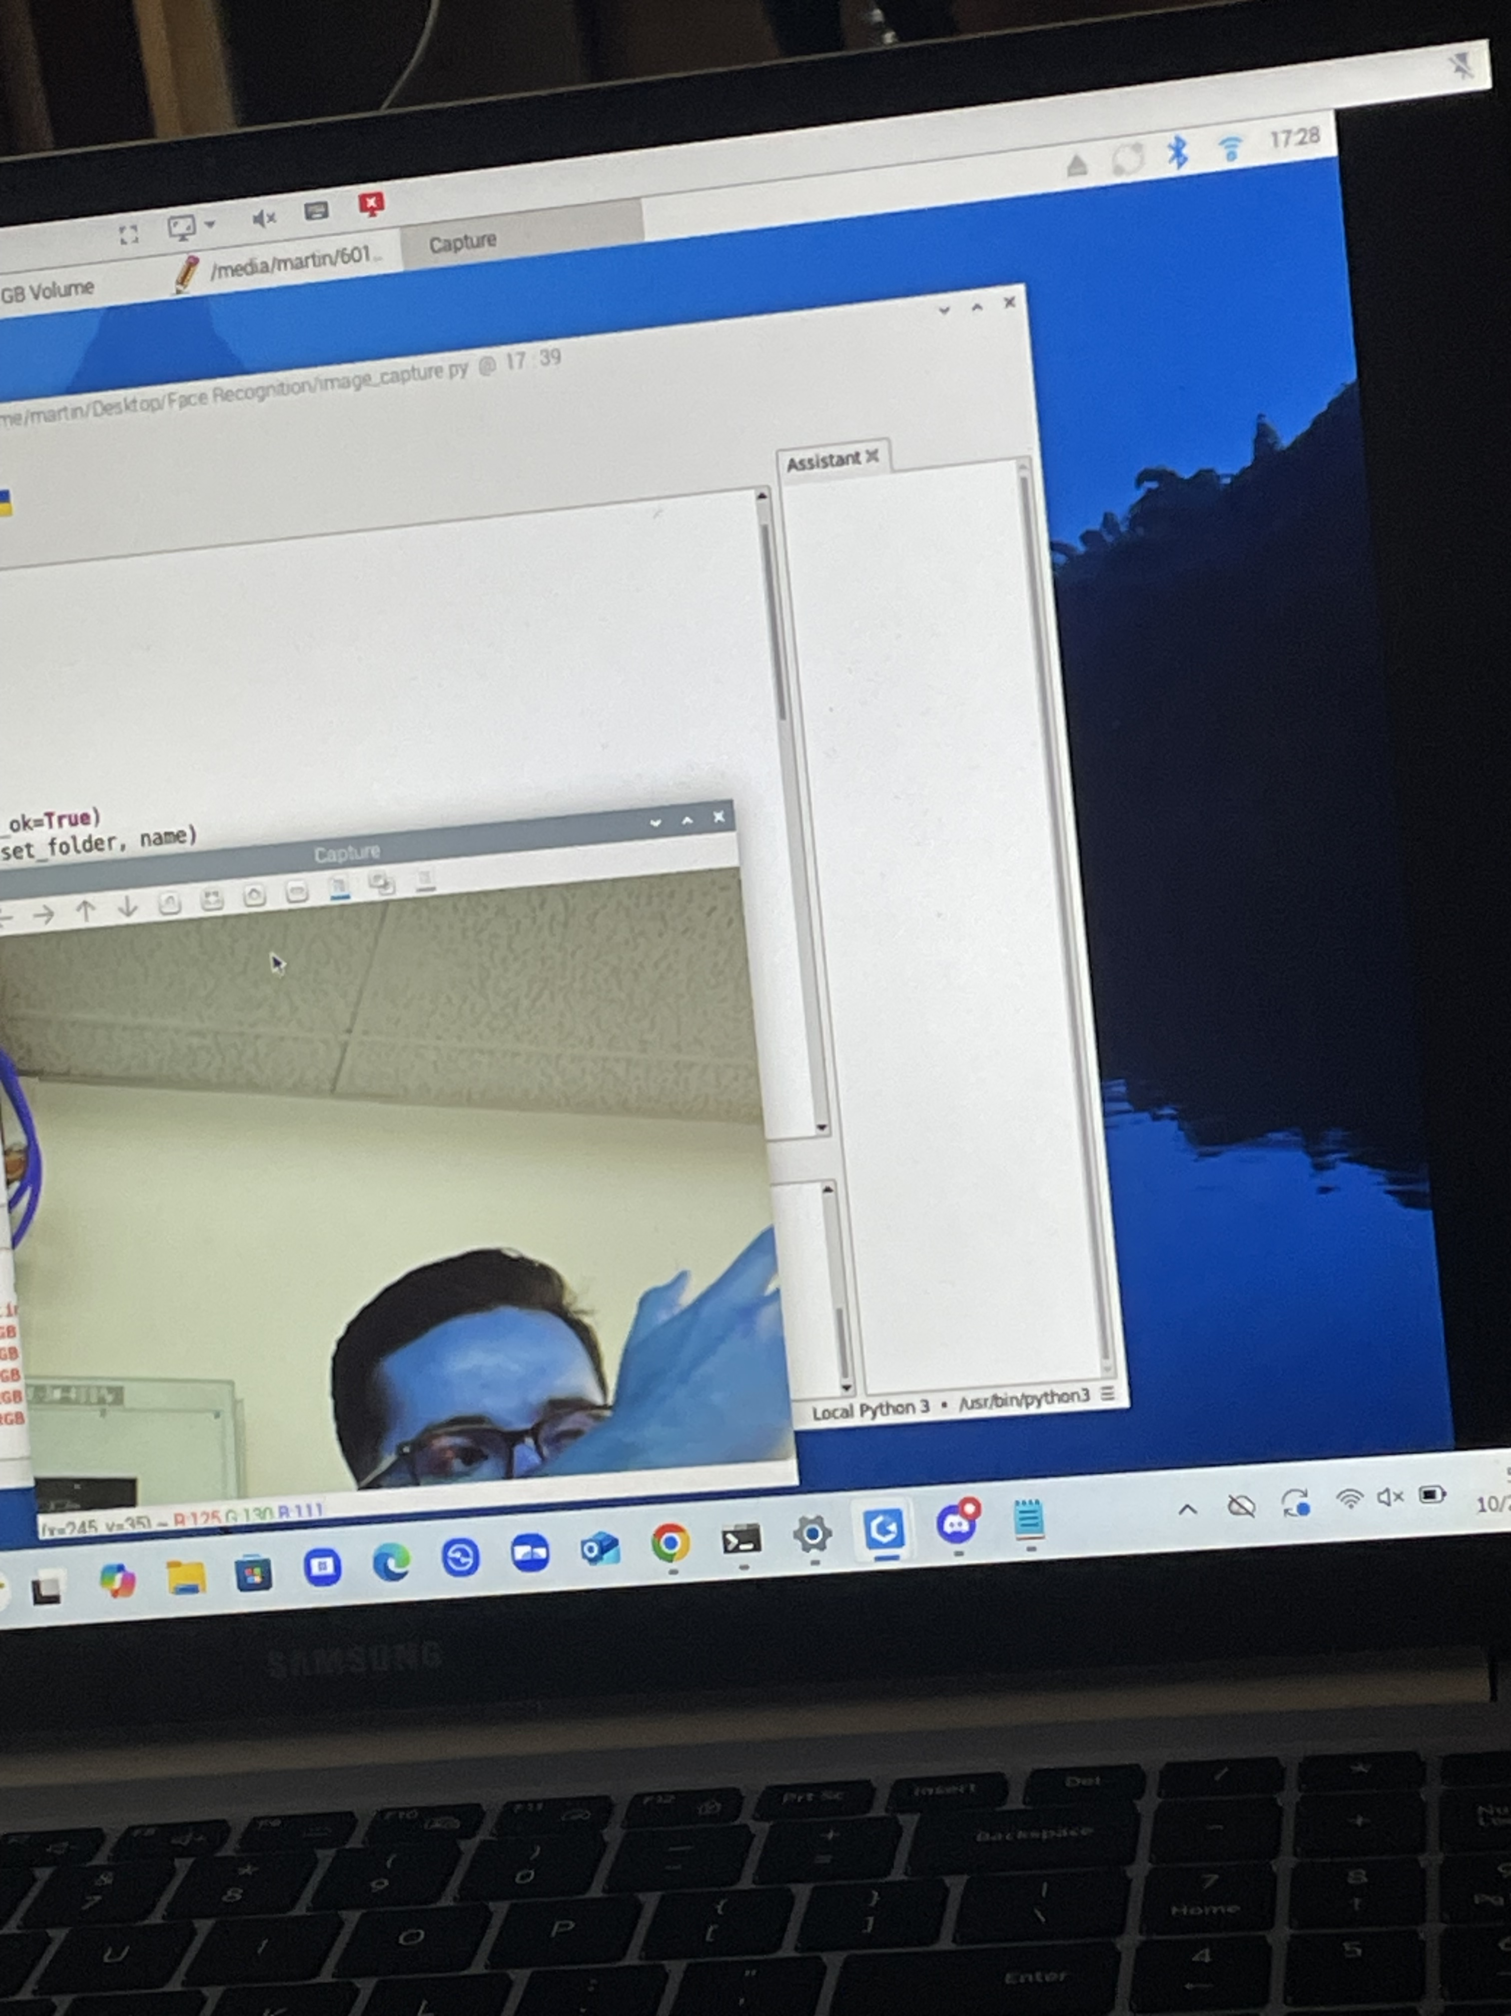
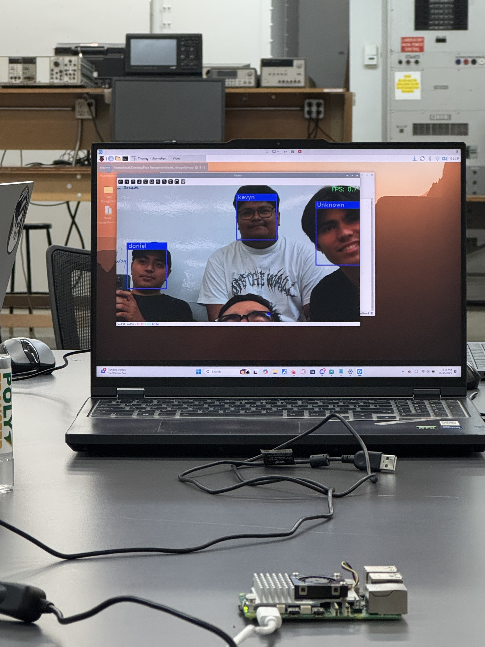
Demonstrations from testing

Slide 14
Analysis
At both resolutions, we noticed that the temperature on the Pi 5 is much higher. We concluded that this is due to the Pi 5's higher power draw.
One discrepancy that we noticed was that the temperatures would go down slightly with more faces introduced. We believe this happens because as the load gets higher, the CPU spends more time idling.
At both resolutions, the Pi 5 performed much better in terms of FPS.
At both resolutions, the Pi 5 used more RAM even though they have the same amount of total RAM.

Slide 15
Conclusion
In terms of performance, it was evident that the Pi 5 was much better. It maintained higher FPS and utilized its resources to a greater extent. Although the Pi 5's temperatures were about 20 degrees higher than the Pi 4's, the performance tradeoff makes it worth the higher power draw.

